Slide 1
SENSORS AND TRANSDUCERS
SENSORS - is a device that detects a change in a physical stimulus and turns it into a signal which can be measured or recorded.

Slide 2
SENSORS AND TRANSDUCERS
TRANSDUCERS - is any device that converts energy in one form to another. The majority either convert electrical energy to mechanical displacement or convert some non-electrical physical quantity, such as temperature, sound or light to an electrical signal.

Slide 3
Transducer can be classified according to their application, based primarily on the physical quantity, property, or condition that is measured.
The transducer can be categories into:
A) Passive transducers: requires an external power output is a measure of some variation, such resistance and capacitance. ex: condenser microphone

Slide 4
B) Self generating transducers: not requiring an external power and they produce analog voltage or current when stimulated by some physical form of energy.
ex: Thermocouple

Slide 5
APPLICATIONS OF TRANSDUCER
Used to measure continuous variables
Temperature
Liquid level
Force
Pressure
Flow
Position

Slide 6
TYPES OF TRANSDUCER
Temperature Transducers
Pressure Transducers
Speed Transducers
Electrical Transducers
Photoelectric Transducers
Electromagnetic Transducers
Electrostatic Transducers
Mechanical transducers
IC Transducer

Slide 7
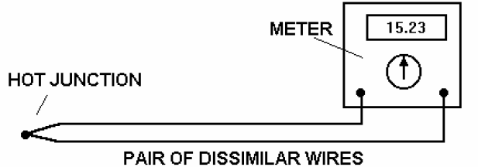
I. TEMPERATURE TRANSDUCERS
1. THERMOCOUPLES
When two wires with dissimilar electrical properties are joined at both ends and one junction is made hot and the other cold, a small electric current is
produced proportional
to the difference in the
temperature.

Slide 8
The relationship is nearly linear over the operating range. The actual characteristic and suitable operating temperatures depends upon the metals used in the wires. The various types are designated in international and national standards. Typical linear operating ranges are shown for standard types.
It is important that thermocouples are standard so that the same EMF will always represent the same temperature.

Slide 9
Thermocouples come in several forms. They may be wires insulated from each other with plastic or fiber glass materials.
For high temperature work, the wire pairs are put inside a tube with mineral insulation. For industrial uses the sensor comes in a metal enclosure such as stainless steel.

Slide 10
Thermocouple have a wide range of temperature from as low as – 270°C up to as high as 2700°C.
Magnitude of the thermal EMF depends on the wire materials used and on the temperature difference between the junctions.

Slide 11
Standard metals and pairs for thermocouple constructions
Chromel – Alumel (type K)
Iron – Constantan (type J)
Copper – Constantan (type T)
Platinum – Rhodium-Platinum (type S, R & B)

Slide 12
Thermocouple Alloy composition
Chromel - 90% nickel and 10% chromium
Alumel - 95% nickel, 2% manganese,
2% aluminium and 1% silicon
Constantan - 45 % nickel - 55% copper

Slide 13
The effective EMF of the thermocouple is given as:
E = c (T1 – T2) + k(T1² – T2²)
where c & k = constants of the thermocouple materials
T1 = temp of the hot junction
T2 = temp of the cold or reference junction

Slide 14
Example: During experiments with a copper – constantan thermocouple, it was found that c = 3.75 x 10¯² mV/°C and k = 4.5 x 10¯⁵ mV/°C². if T1 = 100 °C and the cold junction, T2 is kept in ice. Compute for the resulting EMF.

Slide 15
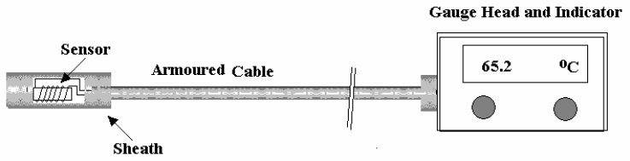
2. RESISTANCE TYPE SENSORS
These work on
the principle that
the electrical resistance of a conductor change with temperature. If a constant voltage is applied to the conductor then the current flowing through it will change with temperature. The resistivity of the conductor change with temperature.

Slide 16
This usually means the resistance gets bigger as the conductor gets hotter.
A basic temperature sensor is made by winding a thin resistance wire into a small sensor head. The resistance of the wire then represents the temperature. This has an advantage over a thermocouple in that it is unaffected by the temperature of the gauge end. The main type of wire used is Platinum.

Slide 17
The sensors are usually manufactured to have a resistance of 100 W at 0°C and a typical operating range of -200°C to 400°C. A special type of resistance sensor is called a Thermistor. They are made from a small piece of semiconductor material. The material is special because the resistance changes a lot for a small change in temperature and so can be made into a small sensor and it costs less than platinum wire. The temperature range is limited.

Slide 18
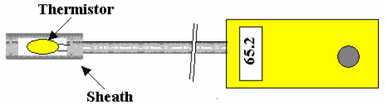
They are only used for a typical range of -20°C to 120°C and are commonly used in small hand held thermometers for every day use.

Slide 19
Thermistors are made of oxides of nickel, manganese or cobalt platinum. The output is not linearly proportional to any temperature scale.
2 types of Thermistor
NTC – Negative Temperature Coefficient
Resistance goes down when temp goes down
PTC – Positive Temperature Coefficient
Resistance goes up when temp goes up

Slide 20
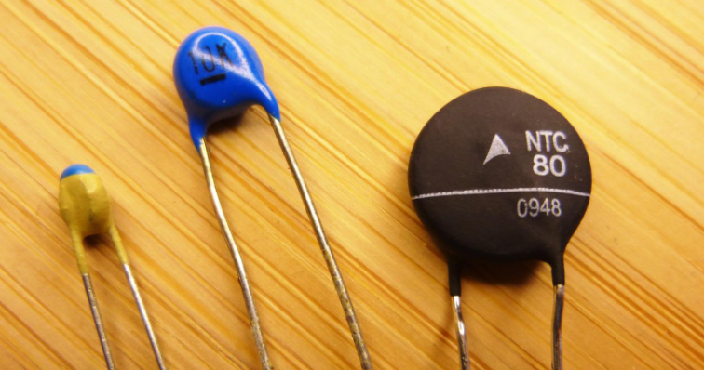

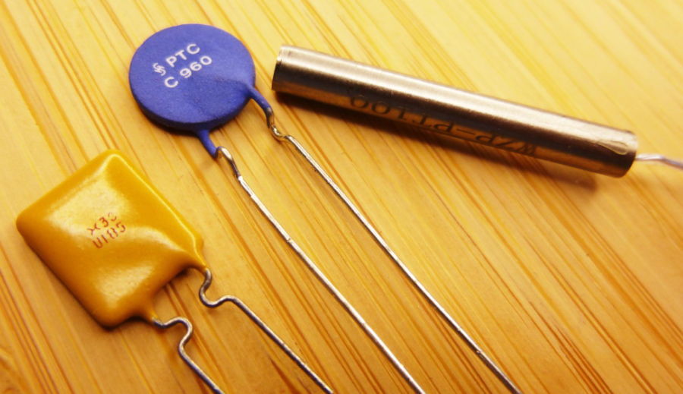
THERMISTOR

Slide 21
NTC Thermistor
Temperature dependent semiconductor resistors. Operates at a range of -200°C to 1000°C, supplied in glass bead, disc, chips or probe formats.
applications:
temperature measurement and control
temperature compensation
surge suppression
fluid flow measurement

Slide 22
PTC Thermistor
Temperature dependent resistors manufactured from barium titanate and should be chosen when a drastic change in resistance is required at a specific temperature or current level.
applications:
temperature sensing
switching of temperature
liquid level sensor

Slide 23
The relationship between temperature and resistance of conductors can be calculated by:
R = Ro (1 + αΔT)
where R = resistance of the conductor at temperature °C
Ro = resistance of the reference temperature, usually 20 °C
α = temperature coefficient of resistance
ΔT = difference between operating and the reference temperature

Slide 24
Example: A platinum resistance thermometer has a resistance of 150 Ω at 20°C. Calculate its resistance at 50°C, if α20 = 0.00392.

Slide 25
3. LIQUID EXPANSION and VAPOUR PRESSURE SENSORS
These are thermometers filled with either a liquid such as mercury or an evaporating fluid such as used in refrigerators. In both cases the inside of the sensor head and the connecting tube are completely full. Any rise in temperature produces expansion or evaporation of the liquid so the sensor becomes pressurized.

Slide 26
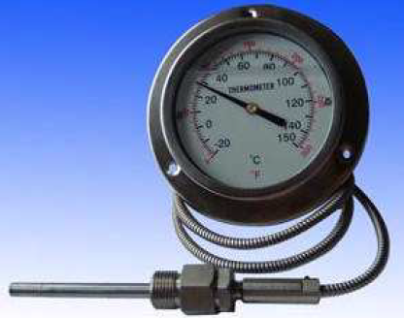
The pressure is related to the temperature and it may be indicated on a simple pressure gauge.
The movement may also directly operate a thermostat. These instruments
are robust and used over a
wide range. They can be fitted
with electric switches to set off
alarms.

Slide 27
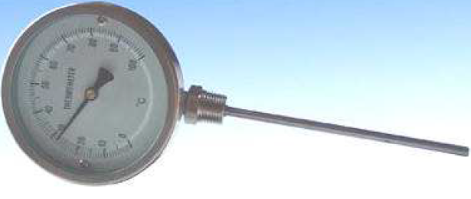
4. BIMETALLIC TYPES
It is a well-known principle that if two metals are rigidly joined together as a two-layer strip and heated, the difference in the expansion rate causes the strip to bend.

Slide 28
The strip is twisted into a long thin coil inside a tube. One end is fixed at the bottom of the tube and the other turns and moves a pointer on a dial. The outward appearance is very similar to the pressure type. They can be made to operate limit switches and set off alarms or act as a thermostat.

Slide 29
II. PRESSURE TRANSDUCERS
BOURDON TUBE
It is a hollow tube with an elliptical cross section. When a pressure difference exists between the inside and outside, the tube tends to straighten out and the end moves. The movement is usually coupled to a needle on a dial to make a complete gauge. It can also be connected to a secondary device such as an air

Slide 30
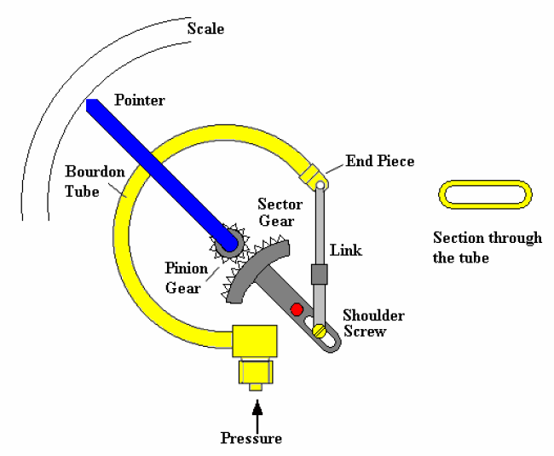
nozzle to control air pressure or to a suitable transducer to convert it into an electric signal. This type can be used for measuring pressure difference.

Slide 31
2. PISTON TYPE
The pressure acts directly on the piston and compresses the spring. The position of the piston is directly related to the pressure. A window in the outer case allows the pressure to be indicated. This type is usually used in
hydraulics where the ability to withstand shock, vibration and sudden pressure changes is needed (shock proof gauge).

Slide 32
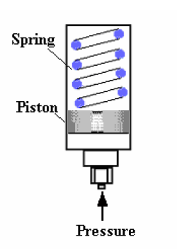
The piston movement may be connected to a secondary device to convert movement into an electrical signal.

Slide 33
3. BELLOWS
A bellows is made of several capsules. These are hollow flattened structures made from thin metal plate. When pressurized the bellows expand and produce mechanical movement. If the bellows is encapsulated inside an outer container, then the movement is proportional to the difference between the pressure on the inside and outside.

Slide 34
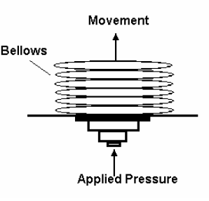
Bellows and single capsules are used in many instruments. They are very useful for measuring small pressures.

Slide 35
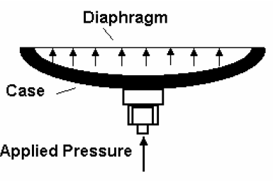
4. DIAPHRAGMS
These are similar in principle to the bellows but the diaphragm is usually very thin and perhaps made of rubber. The diaphragm expands when very small pressures are applied.
The movement is transmitted
to a pointer on a dial through
a fine mechanical linkage.

Slide 36
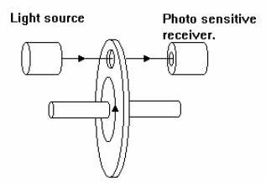
III. SPEED TRANSDUCERS
1. OPTICAL TYPES
These use a light beam and a
light sensitive cell. The beam is
either reflected or interrupted so that pulses are produced for each revolution. The pulses are then counted over a fixed time and the speed obtained. Electronic processing is required to time the pulses and turn the result into an analog or digital signal.

Slide 37
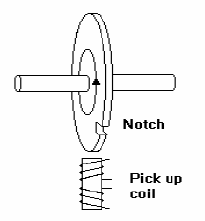
2. MAGNETIC PICK UPS
Uses an inductive coil placed near
to the rotating body. A small magnet
on the body generates a pulse every
time it passes the coil. If the body is made of ferrous material, it will work without a magnet. A discontinuity in the surface such as a notch will cause a change in the magnetic field and generate a pulse.

Slide 38
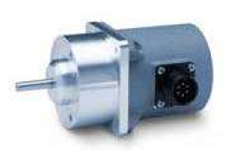
3. TACHOMETERS
Very often the tachometer is built into electric motors to measure their speed. The frequency of the voltage represents the speed of rotation. The frequency must be counted and processed.

Slide 39
IV. FLOW METERS
A flow meter or a flow sensor is a type of flow instrument that is used to indicate the amount of liquid, gas, or vapor moving through a pipe or conduit by measuring linear, non-linear, mass, or volumetric flow rates. Since flow control is often essential, measuring the flow of liquids and gasses is a critical need for many industrial applications – and there are many

Slide 40
different types of flow meters that can be utilized depending on the nature of the application. They may be classified as follows:
POSITIVE DISPLACEMENT TYPES
INFERENTIAL TYPES
VARIABLE AREA TYPES
DIFFERENTIAL PRESSURE TYPES

Slide 41
1. POSITIVE DISPLACEMENT TYPES
These types have a mechanical element that makes the shaft of the meter rotate once for an exact known quantity of fluid. The quantity of fluid hence depends on the number of revolutions of the meter shaft and the flow rate depends upon the speed of rotation. Both the revolutions and speed may be measured with mechanical or electronic devices.

Slide 42
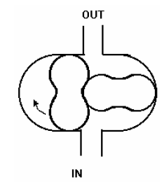
Meshing Motor type consists of two rotors with lobes. When fluid is forced in, the rotors turn and operate the indicating system.

Slide 43
2. INFERENTIAL TYPE METERS
The flow of the fluid is inferred from some effect produced by the flow. Usually this is a rotor which is made to spin and the speed of the rotor is sensed mechanically or electronically.
The main types are:
Turbine rotor types Rotary shunt types
Rotating vane types Helical turbine types

Slide 44
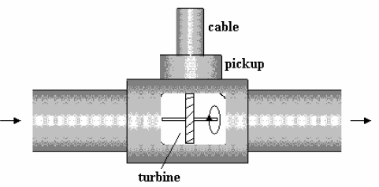
TURBINE TYPE
The turbine type has an axial rotor which is made to spin by the fluid and the speed represents the flow rate. This may be sensed electrically by coupling the shaft to a small electric tachometer.

Slide 45
Often this consists of a magnetic slug on the rotor which generates a pulse of electricity each time it passes the sensor.

Slide 46
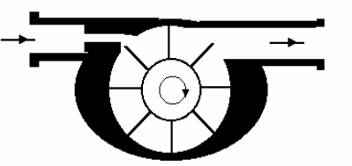
ROTATING VANE TYPE
The jet of fluid spins around the rotating vane and the speed of the rotor is measured mechanically or electronically.

Slide 47
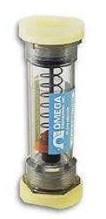
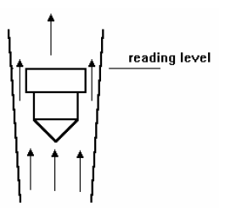
3. VARIABLE AREA TYPES
FLOAT TYPE
The float is inside a tapered tube. The fluid flows through the annular gap around the edge of the float. The restriction causes a pressure

Slide 48
drop over the float and the pressure forces the float upwards. Because the tube is tapered, the restriction is decreased as the float moves up. Eventually a level is reached where the restriction is just right to produce a pressure force that counteracts the weight of the float. The level of the float indicates the flow rate. If the flow changes the float moves up or down to find a new balance position.

Slide 49
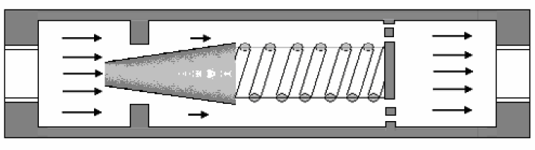
TAPERED PLUG TYPE
A tapered plug is aligned inside a hole or orifice. A spring holds it in place. The flow is restricted as it passes through the gap and a force is produced which moves the plug. Because it is tapered the restriction changes and the plug

Slide 50
takes up a position where the pressure force just balances the spring force. The movement of the plug is transmitted with a magnet to an indicator on the outside.

Slide 51
4. DIFFERENTIAL PRESSURE FLOW METERS
These are a range of meters that convert flow rate into a differential pressure:
ORIFICE METERS
VENTURI METERS
NOZZLE METERS
PITOT TUBES

Slide 52
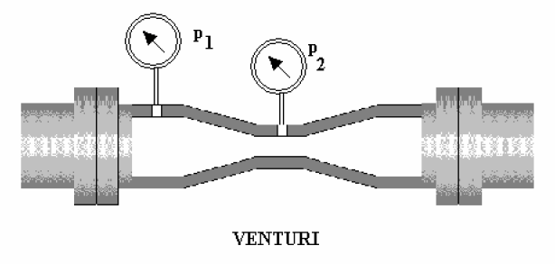
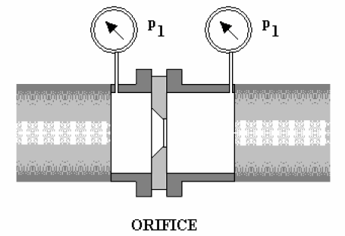
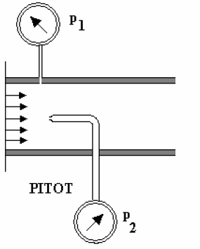
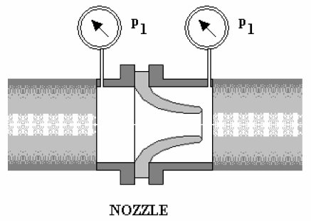
Cross section view

Slide 53
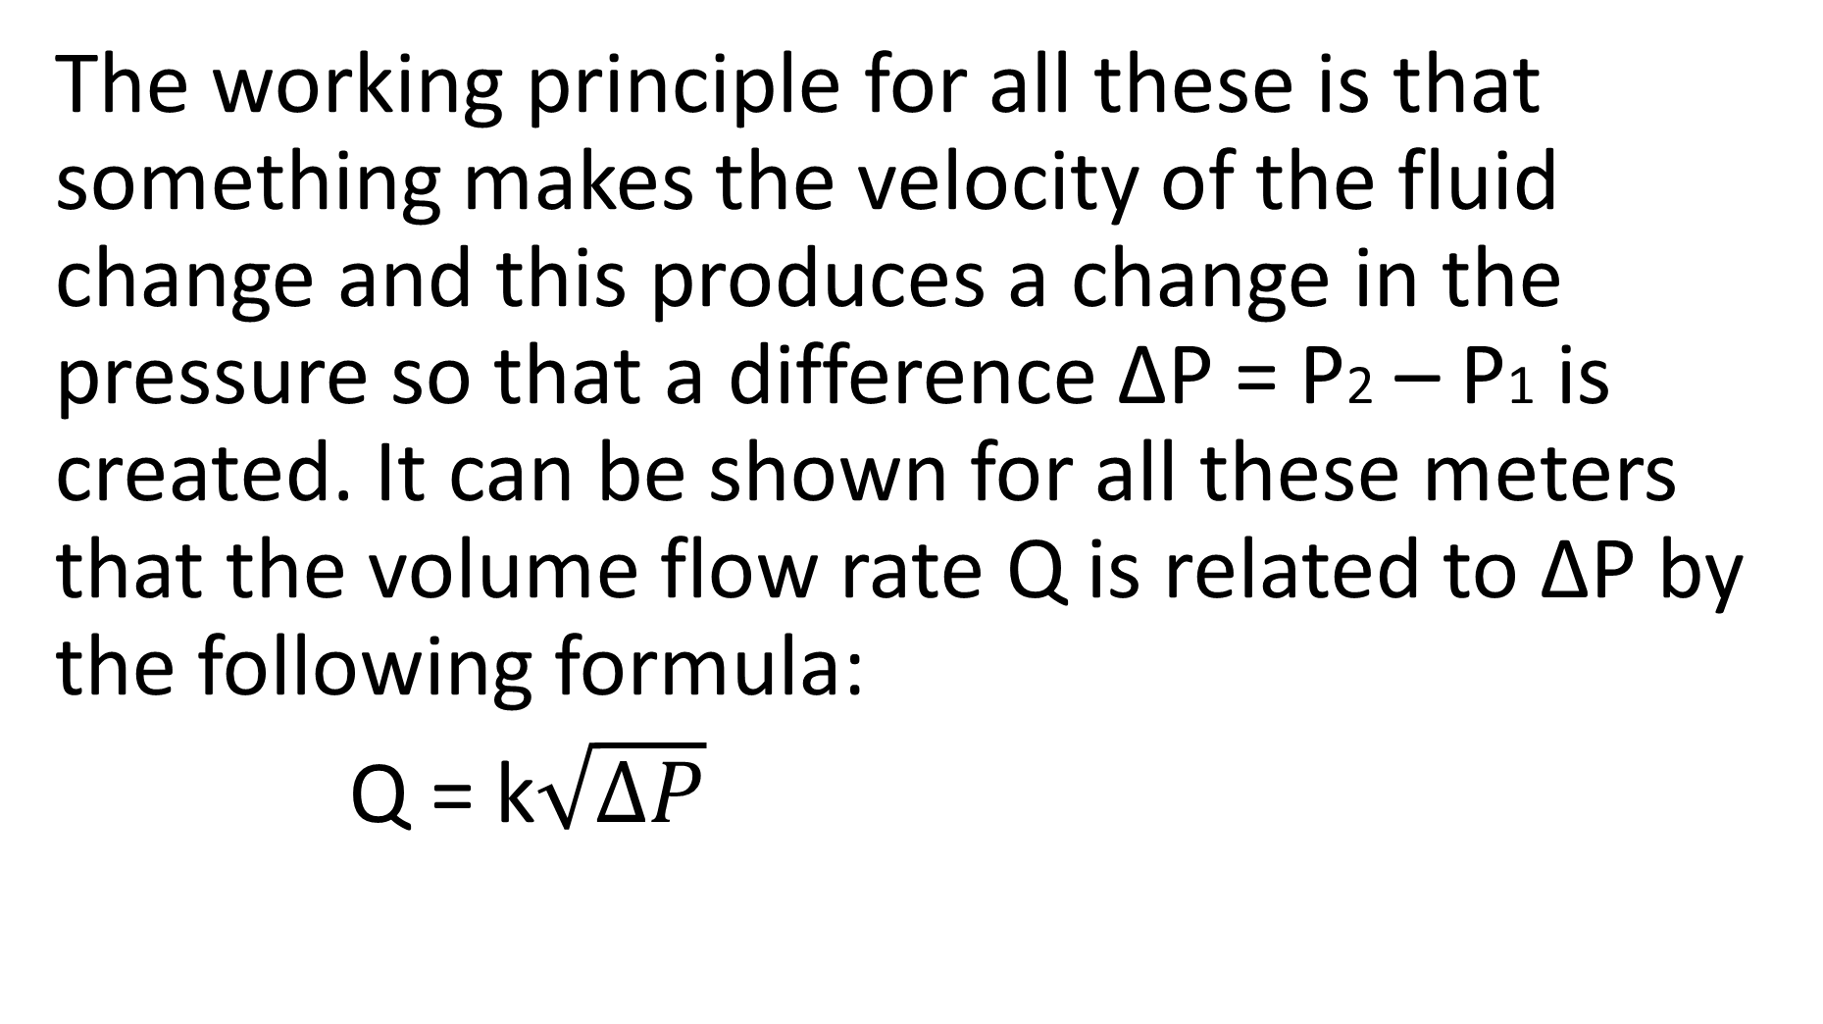
The working principle for all these is that something makes the velocity of the fluid change and this produces a change in the pressure so that a difference ΔP = P2 – P1 is created. It can be shown for all these meters that the volume flow rate Q is related to ΔP by the following formula:
Q = k$\sqrt{ΔP}$

Slide 54
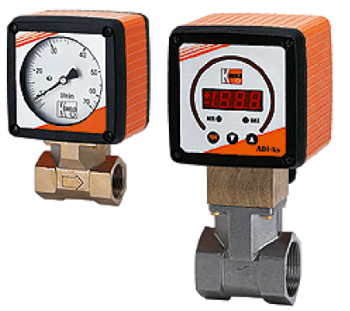
k is the meter constant.
Extra instrumentation heads can be fitted to produce an:
electrical output
(4 mA – 20 mA) or a pneumatic output
(0.2 bar – 1 bar).

